Slide 1



Slide 2

Presentation Salers Breed and bull station
03/05/2024

Slide 3


The Salers breed in France in few numbers :
The Herd-Book Salers:
400 breeders
24 000 animals
The Groupe Salers Evolution:
About twenty partners

Slide 4
Herd Book Salers?
To be at Herd Book Salers, you must have at least annual follow-up from a technician (or Herd Book Salers or by the company in charge of the growth control.
For the national show or to put a calf at the Station, the breeding have to weight all the calves : It’s important to know the weight at 120 days (milk performance of the mother) and at 210 days (own performances). That job is realized by a company who helping farmers to progress, give advices on nutrition ..
Also, all the calves (males and females) have to be scored at weining : it’s a morphological scoring with 19 individuals positions. That is a first sorting of the best calves on the breed.
After that, the technician of the Herd Book Salers can choose the best calves for the Bull Station (they need to have a good score and a high weight at 210 days (7 months).
The technician of the Herd Book Salers scored the heifers at 2 years old and do an other one at 4 years old. We get a grade near 70 points.
All the results are important to calculate the index and qualifications of the animals.

Slide 5
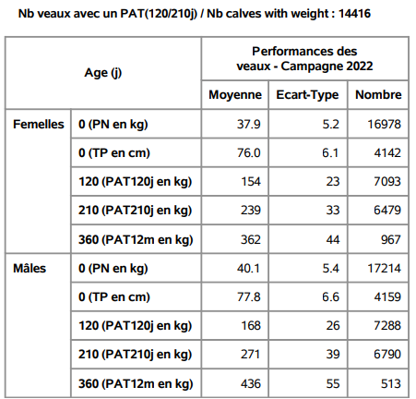
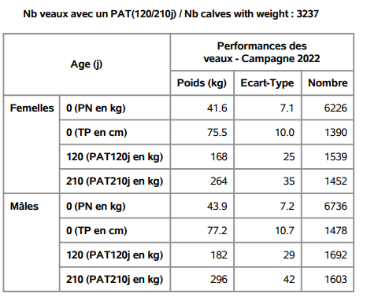
The format of the Salers :
Salers calves
Salers cross calves

Slide 6
The SALERS SELECTION SCHEME :
Selection on descendants
The performances of the descendants are integrated into the calculation of the indexation of the animals. The generation interval is more important than the two previous methods. This type of selection is necessary when the animals to be evaluated are likely to generate a large number of offspring over several campaigns (animal insemination bulls, embryo donors), and when measuring the characteristics is impossible on the candidates (example of the milk production for a bull). This method can also be applied in the case of characters for which selection on ancestry and individual selection are not very precise.
The joint use of several selection methods makes it possible to combine the advantages of each: this is the implementation of the selection program. This organization also allows the best breeders to be mated together.
On an individual level, each breeder can also combine the advantages of these methods. Indeed, choosing your animals based on origins (i.e. ancestry) is already a good thing, but it is essential to also take into account the performance of the individual, and that of their descendants.

Slide 8
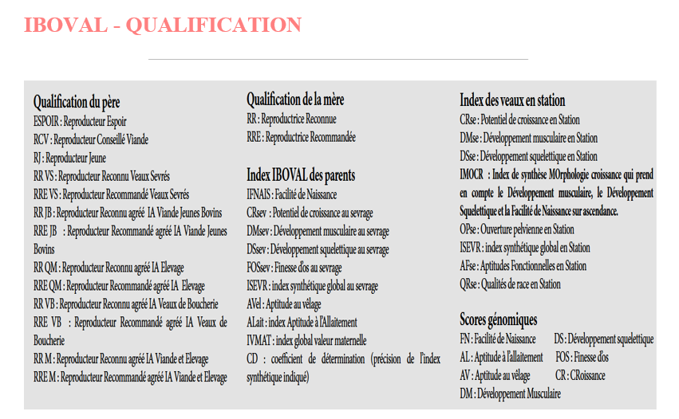

Slide 9
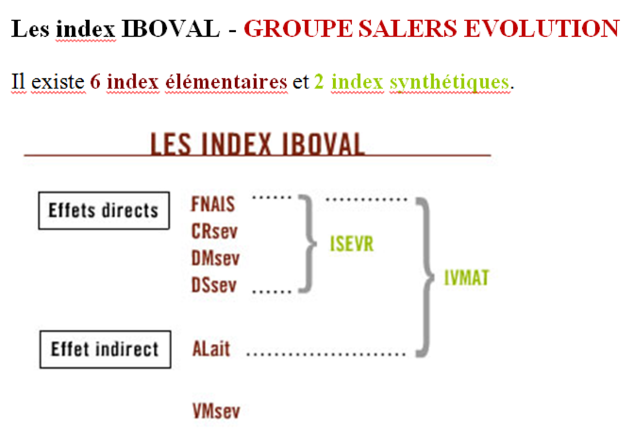

Slide 10
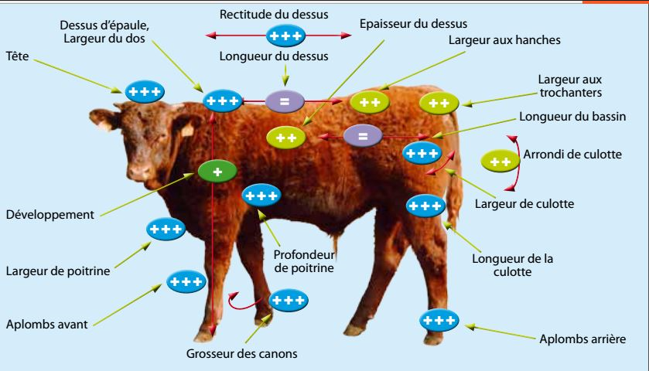

Slide 11
HVALA NA PAŽNJI !

